Slide 1
Dynamic Programming
0-1 Knapsack

Slide 2
0/1 Knapsack Problem
Given,
W, total weight capacity
List of the weights of some items, w_{i}
List of the values or prices of those items, v_{i} or p_{i}
Objective: pick some items such as the capacity does not exceed and also the value is maximized.

Slide 3
0/1 Knapsack Problem
Example:
W = 8
w_{i} = {3, 4, 5, 6}
p_{i} = {2, 3, 4, 1}
n = 4
Solution 1: Brute Force

Slide 4
0/1 Knapsack Problem
Brute Force Solution:
If we choose a item we put 1 and otherwise 0.
So, the solutions can be
{1, 0, 0, 1}
{0, 1, 1, 0}
.
.
.
.
.
2^{n} = 2⁴ = 16 possible solutions
Example:
W = 8
w_{i} = {3, 4, 5, 6}
p_{i} = {2, 3, 4, 1}
n = 4

Slide 5
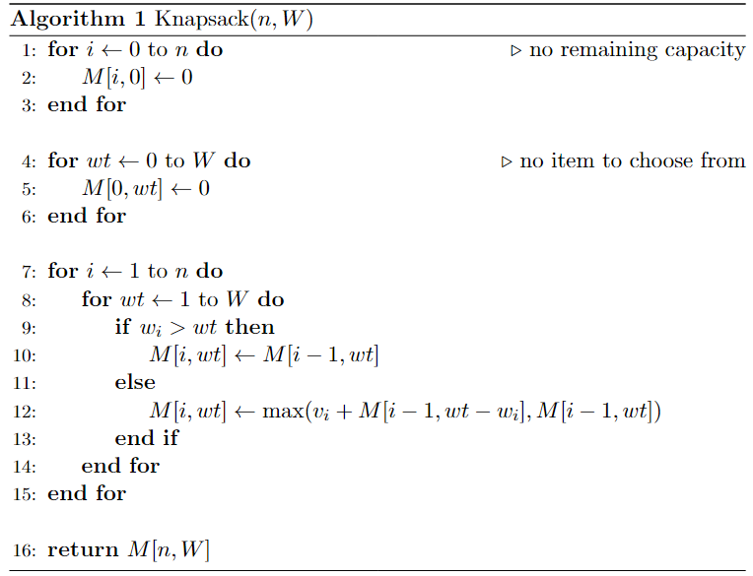
0/1 Knapsack Problem
Can’t take i-th item as its weight w_{i} exceeds capacity wt
Value after taking the i-th item
Value without taking the i-th item

Slide 6
0/1 Knapsack Problem
Dynamic Programming Solution:
Formula for filling up a cell:
Suppose the cell is M[i, wt]
0 if i = 0 or wt = 0
M[i, wt] = M[i-1, wt] if w_{i} > wt
max (v[i] + M[i-1, wt - w[i]], M[i-1, wt]) otherwise
W = 8
w_{i} = {3, 4, 5, 6}
p_{i} = {2, 3, 4, 1}
n = 4

Slide 7
0/1 Knapsack Problem
wt
Fill the tables:
p_{i} | w_{i} |  | 0 | 1 | 2 | 3 | 4 | 5 | 6 | 7 | 8
 |  | 0 | 0 | 0 | 0 | 0 | 0 | 0 | 0 | 0 | 0
2 | 3 | 1 | 0
3 | 4 | 2 | 0
4 | 5 | 3 | 0
1 | 6 | 4 | 0
W = 8
W_{i} = {3, 4, 5, 6}
P_{i} = {2, 3, 4, 1}
i

Slide 8
0/1 Knapsack Problem
wt
Fill the tables:
p_{i} | w_{i} |  | 0 | 1 | 2 | 3 | 4 | 5 | 6 | 7 | 8
 |  | 0 | 0 | 0 | 0 | 0 | 0 | 0 | 0 | 0 | 0
2 | 3 | 1 | 0 | 0 | 0 | 2 | 2 | 2 | 2 | 2 | 2
3 | 4 | 2 | 0 | 0 | 0 | 2 | 3 | 3 | 3 | 5 | 5
4 | 5 | 3 | 0 | 0 | 0 | 2 | 3 | 4 | 4 | 5 | 6
1 | 6 | 4 | 0 | 0 | 0 | 2 | 3 | 4 | 4 | 5 | 6
W = 8
W_{i} = {3, 4, 5, 6}
P_{i} = {2, 3, 4, 1}
Answer
i

Slide 9
0/1 Knapsack Problem
Starting from the answer cell, check the upper cell.
If the values are same, then don’t select the item, otherwise select that.
Now, find out the remaining profit in the upper row.
Find the items:
p_{i} | w_{i} | wt | 0 | 1 | 2 | 3 | 4 | 5 | 6 | 7 | 8
 |  | 0 | 0 | 0 | 0 | 0 | 0 | 0 | 0 | 0 | 0
2 | 3 | 1 | 0 | 0 | 0 | 2 | 2 | 2 | 2 | 2 | 2
3 | 4 | 2 | 0 | 0 | 0 | 2 | 3 | 3 | 3 | 5 | 5
4 | 5 | 3 | 0 | 0 | 0 | 2 | 3 | 4 | 4 | 5 | 6
1 | 6 | 4 | 0 | 0 | 0 | 2 | 3 | 4 | 4 | 5 | 6
W = 8
W_{i} = {3, 4, 5, 6}
P_{i} = {2, 3, 4, 1}
Same, So don’t select this
Answer
Solution: { , , ,0}

Slide 10
0/1 Knapsack Problem
Starting from the answer cell, check the upper cell.
If the values are same, then don’t select the item, otherwise select that.
Now, find out the remaining profit in the upper row.
Find the items:
p_{i} | w_{i} | wt | 0 | 1 | 2 | 3 | 4 | 5 | 6 | 7 | 8
 |  | 0 | 0 | 0 | 0 | 0 | 0 | 0 | 0 | 0 | 0
2 | 3 | 1 | 0 | 0 | 0 | 2 | 2 | 2 | 2 | 2 | 2
3 | 4 | 2 | 0 | 0 | 0 | 2 | 3 | 3 | 3 | 5 | 5
4 | 5 | 3 | 0 | 0 | 0 | 2 | 3 | 4 | 4 | 5 | 6
1 | 6 | 4 | 0 | 0 | 0 | 2 | 3 | 4 | 4 | 5 | 6
Not same, So select this.
Remaining Profit: 6 - 4 = 2.
W = 8
W_{i} = {3, 4, 5, 6}
P_{i} = {2, 3, 4, 1}
Answer
Solution: { , , 1, 0}

Slide 11
0/1 Knapsack Problem
Starting from the answer cell, check the upper cell.
If the values are same, then don’t select the item, otherwise select that.
Now, find out the remaining profit in the upper row.
Now Find the items:
p_{i} | w_{i} | wt | 0 | 1 | 2 | 3 | 4 | 5 | 6 | 7 | 8
 |  | 0 | 0 | 0 | 0 | 0 | 0 | 0 | 0 | 0 | 0
2 | 3 | 1 | 0 | 0 | 0 | 2 | 2 | 2 | 2 | 2 | 2
3 | 4 | 2 | 0 | 0 | 0 | 2 | 3 | 3 | 3 | 5 | 5
4 | 5 | 3 | 0 | 0 | 0 | 2 | 3 | 4 | 4 | 5 | 6
1 | 6 | 4 | 0 | 0 | 0 | 2 | 3 | 4 | 4 | 5 | 6
Same, So don’t select this
W = 8
W_{i} = {3, 4, 5, 6}
P_{i} = {2, 3, 4, 1}
Answer
Solution: { , 0, 1, 0}

Slide 12
0/1 Knapsack Problem
Starting from the answer cell, check the upper cell.
If the values are same, then don’t select the item, otherwise select that.
Now, find out the remaining profit in the upper row.
Now Find the items:
p_{i} | w_{i} | wt | 0 | 1 | 2 | 3 | 4 | 5 | 6 | 7 | 8
 |  | 0 | 0 | 0 | 0 | 0 | 0 | 0 | 0 | 0 | 0
2 | 3 | 1 | 0 | 0 | 0 | 2 | 2 | 2 | 2 | 2 | 2
3 | 4 | 2 | 0 | 0 | 0 | 2 | 3 | 3 | 3 | 5 | 5
4 | 5 | 3 | 0 | 0 | 0 | 2 | 3 | 4 | 4 | 5 | 6
1 | 6 | 4 | 0 | 0 | 0 | 2 | 3 | 4 | 4 | 5 | 6
Not same, So select this.
Remaining Profit: 2-2 = 0.
Reached 0th row.
W = 8
W_{i} = {3, 4, 5, 6}
P_{i} = {2, 3, 4, 1}
Answer
Solution: { 1, 0, 1, 0}

